Slide 1

Challenging Times Matched to Extraordinary Efforts
A Discussion with the Board of Trustees
September 18, 2020

Slide 2

Overview

Slide 3
Operating a University During a Pandemic
Intensive scenario planning resulted in actions to mitigate the negative outcomes to the extent possible. Examples:
3% cut in units’ education and general fund budgets.
Hiring restrictions and plan for zero GSI for faculty and staff.
2020-21 tuition freeze (third consecutive year for PA resident students) and reduced tuition for summer courses.
Capital cost saving measures including delayed or deferred capital projects.
Secured $250 million line of credit to smooth out the financial impact.

Slide 4
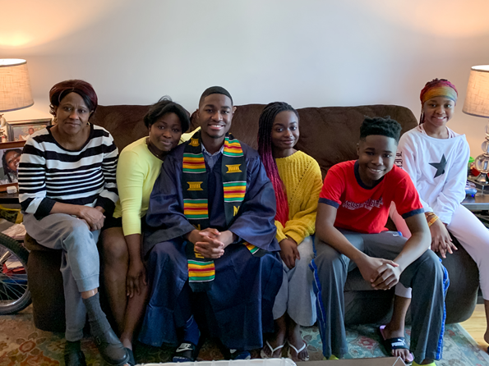
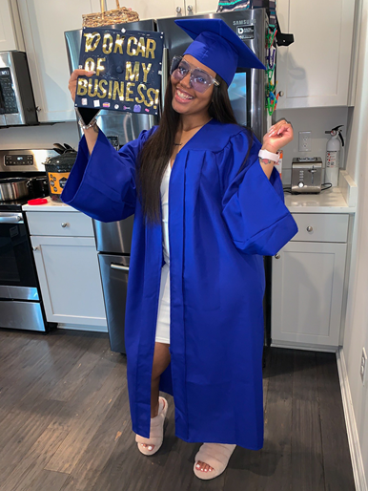

There Were Still Reasons to Celebrate
Spring and Summer Commencements
Penn State held virtual commencement ceremonies this spring to celebrate 14,244 new graduates university-wide; ceremony had 92,000 views in 121 countries.
A virtual commencement ceremony in August marked the graduation of 2,868 undergraduate and graduate students.

Slide 5
Career Services Supported Students With New Tools
Implemented a comprehensive array of virtual career services, programs, and resources for students, alumni, and employers.
Delivered the highest student and alumni attendance (839 total) at the Big 10 Virtual Career fair.
Generated a library of grab-and-go workshops.
Transitioned in-person career fairs to virtual format for Fall 2020.
Developed a virtual recruitment series, Tuesday Talks with Recruiters, and delivered a virtual system-wide 2020 Career Development Professionals Conference.

Slide 6
Summer Enrollment Comparison
(Total Aggregate; doesn’t include Hershey, Dickinson Law, and Penn College)
Course enrollments were up for Maymester (+4%), Session I (+36%), and Session II (+17%), but the cancellation of all summer study abroad programs brought down total summer enrollment resulting in a total change of +1.0% across the university.
 | June 30, 2019 | June 30, 2020
University Park | 16,308 | 16,174
Commonwealth Campuses | 7,235 | 7,373
World Campus | 9,217 | 9,568
Total University | 32,760 | 33,115

Slide 7
Fall Enrollment Comparison
Total Aggregate; doesn’t include Hershey, Dickinson Law, and Penn College
 | Sept. 10, 2019 | Sept. 10, 2020
University Park | 47,365 | 46,423
Commonwealth Campuses | 28,658 | 27,159
World Campus | 14,969 | 15,563
Total University | 90,992 | 89,145

Slide 8
Deferrals by Admitted Students
To 2021 Spring or Fall
 | Fall 2019 | Fall 2020
University Park | 112 | 555
Commonwealth Campuses | 140 | 466
World Campus | 176 | 148
Total University | 428 | 1,169

Slide 9
Leave of Absence: Matriculated Students
Total Aggregate; doesn’t include Hershey, Dickinson Law, and Penn College
 | Fall 2019 | Fall 2020
University Park | 313 | 650
Commonwealth Campuses | 208 | 319
World Campus | 177 | 172
Total University | 698 | 1,141

Slide 10
Student Account Payments and Financial Aid
As of Sept. 9, student accounts payments for Fall Semester 2020 of $386.9M are trailing student accounts payments for Fall Semester 2019
of $409.8M, a decrease of $22.8M or 5.6%.
Fall 2020 financial aid disbursements, which include federal, state, institutional and private funding sources, are currently at $470M,
which is on par with aid disbursement totals at this time last fall.
Although these are indications of a reasonably solid enrollment for the fall, year-over-year differences in tuition payments and student aid can vary significantly based on when the payment due dates fall.

Slide 11
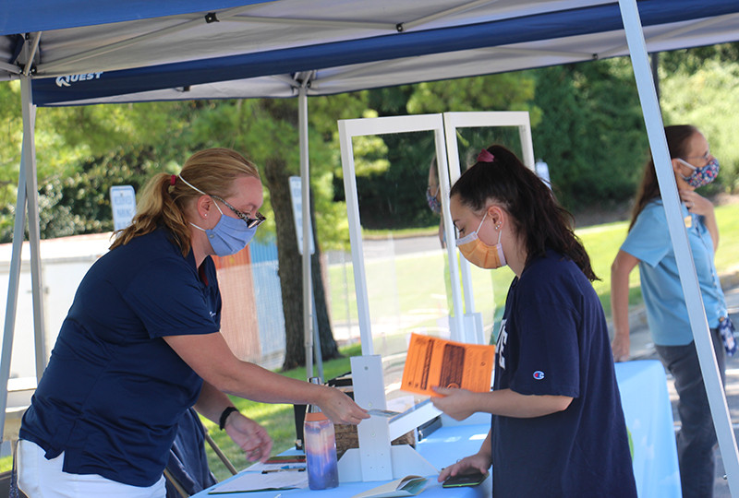
Residence Life
Residence Halls
10,155 students living on campus
at University Park; at 72% capacity.
3,617 students living at the Commonwealth Campuses;
at 60% capacity.

Slide 12
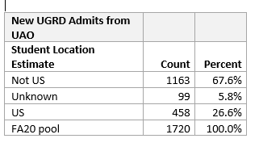
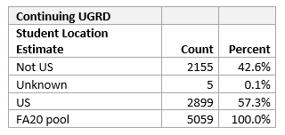
International Undergraduate Students
Notes:
UAO is the Undergraduate Admission Office

Slide 13
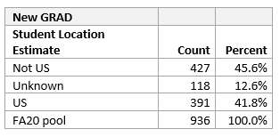
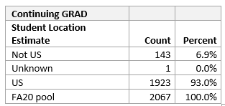
International Graduate Students

Slide 14
University-wide Course Delivery Schedule
In Fall 2020, just less than half of all course sections offered University-wide were delivered in an in-person or hybrid mode.
    4,868 (18.6%) course sections are fully in-person.
    7,416 (28.3%) course sections are mixed mode, which is a
    combination of in-person and remote learning.
    9,658 (36.9%) course sections are remote synchronous.
    4,237 (16.1%) course sections are remote asynchronous.

Slide 15


Slide 16
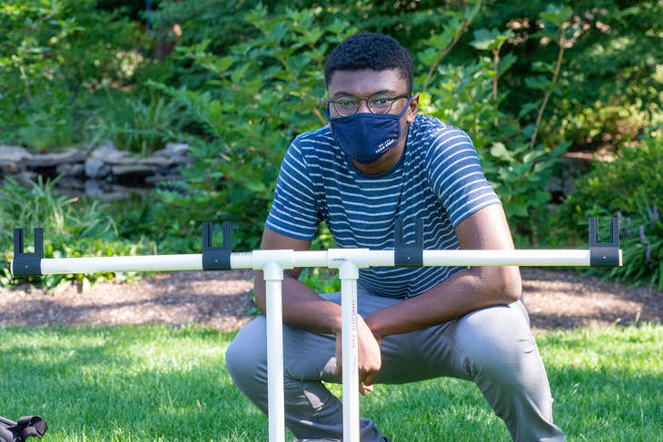
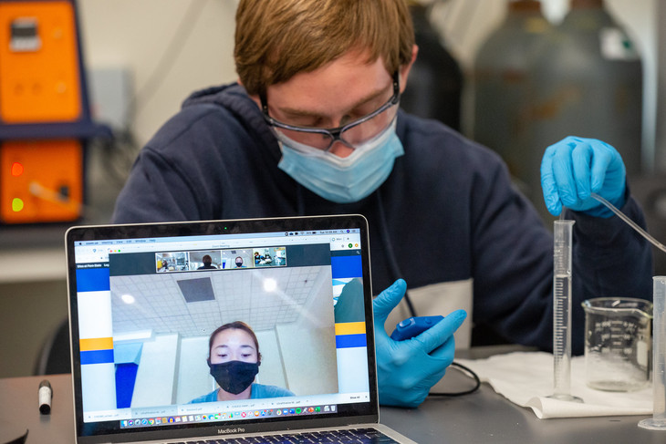
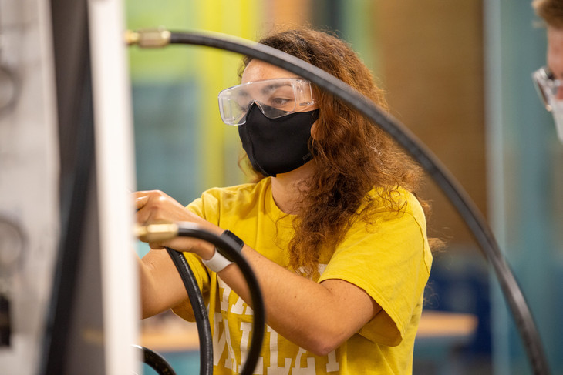
Labs Use New Protocols and PPE
Science, engineering, health, and performing arts programs require hands-on interactions, so new protocols were developed.
Students alternate weekly for in-person and online instruction; those not living near campus attend on Zoom.
Lab tables have Plexiglass dividers, and students disinfect their workstations with wipes.
Masks and gloves are required; students may also wear clear face shields for added safety.
Classes are held outdoors, weather permitting.

Slide 17

Introducing Renée Bishop-Pierce
Associate Professor of Biology
Penn State Scranton
Chair, Faculty Affairs Committee,
University Faculty Senate
Faculty, Penn State First Shanghai

Slide 18
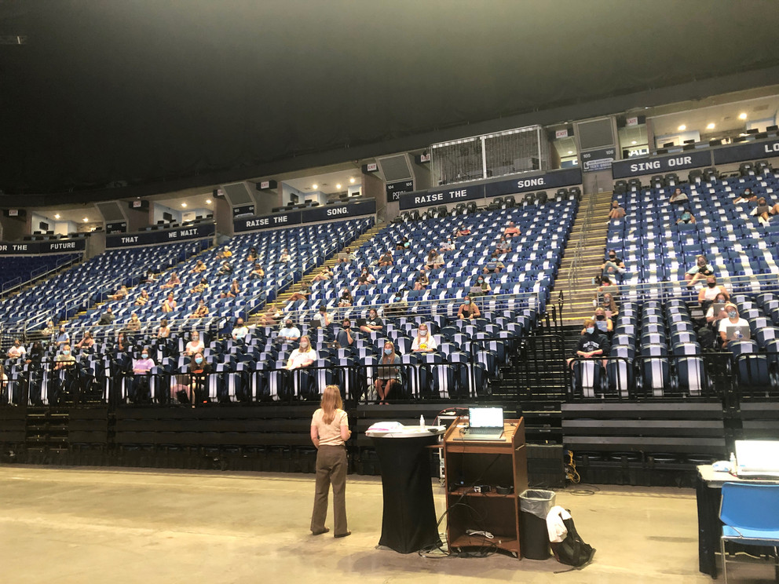
Introducing Peggy Van Meter
Associate Professor of Education
(Educational Psychology)
Teaching EDPSY 11 for 125 students;
class meets in the Bryce Jordan Center

Slide 19

Research

Slide 20
Research Expenditures and Awards
FY20 Expenditures
FY19 FY20
$968M $1007.9M
Up 4.1%
FY21 Awards to Date
July 1 – Sept 8, 2020 Awards
FY20 FY21
$175M $195M
Up 11.8%

Slide 21
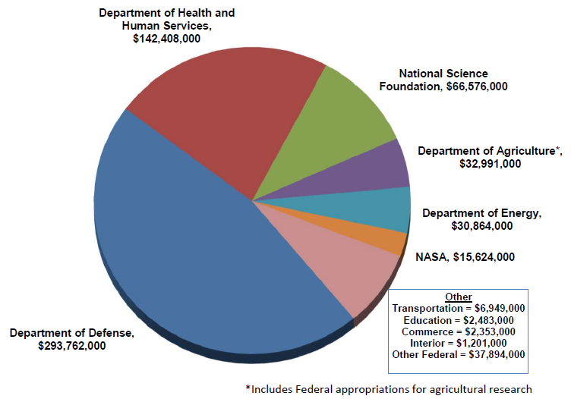
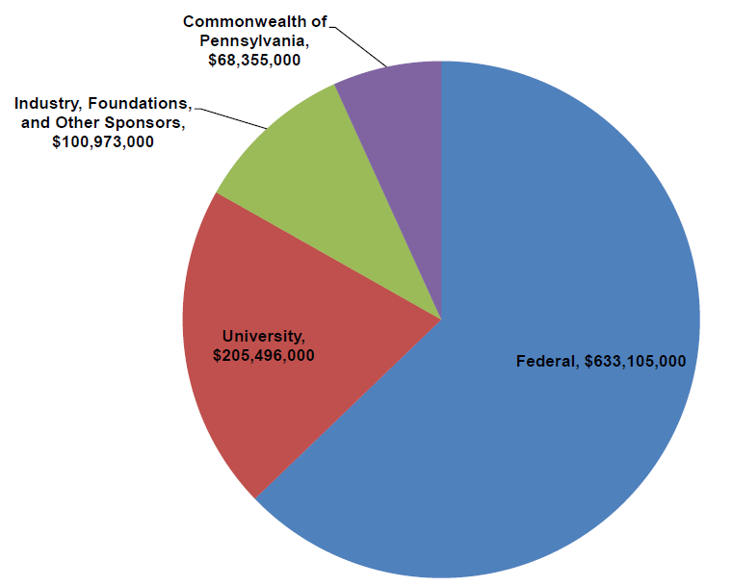
Research Expenditures by Source of Funds
Research Expenditures by Source of Funds
FY2020 Total = $1,007,929,000
Research Expenditures from Federal Agencies
FY2020 Total = $633,105,000

Slide 22
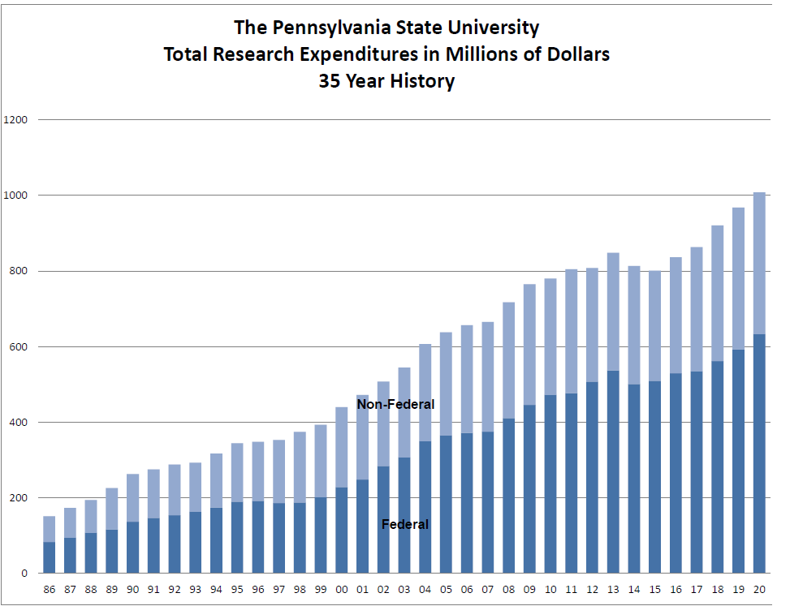
Total Research Expenditures – 35 Year History
Millions of Dollars
Non-Federal
Federal
Year

Slide 23
COVID-19 Impacts on Research
Measures Taken to Ensure Continuity in the Research Enterprise
Sustaining safe research activities during the pandemic.
Facilitating remote research.
Sustaining core research facilities, which are now at ~80% of pre-COVID-19 activity; Lost Revenue >$2M.
Cautiously eased restrictions on undergraduates and graduate students.
Sponsors offered ~$16M in supplemental awards including support for grad students.

Slide 24

Fund Raising in a Time of Stress

Slide 25
Fiscal year 19-20 in Review
$381,323,670 in commitments – a new record.
$290,309,868 in receipts – second highest total ever.
The Tackle Hunger Challenge raised $213,183 in support for food pantries.
Over $650,000 raised for the Student Care and Advocacy Emergency Fund.
$15.5M raised for the new home for the Palmer Art Museum.

Slide 26
A Strong Start to 2020-21
In the first two months of this fiscal year, we have had a strong start,
but COVID and the election could present challenges ahead.
Fiscal Year to Date: July 1 through August 31
 | FY’20 | FY’21
Receipts | $35.3M | $35.2M
Commitments | $34.7M | $32.5M
Donors | 12,133 | 12,280
Alumni Donors | 5,654 | 5,650

Slide 27
Educational Equity Matching Program
Raised Since July 1, 2020
Established four matching opportunities: 2:1 match University-wide; 2:1 match Millennium Scholars; 2:1 match Bunton-Waller; and 1:1 match Unit designation.
As of Sept. 10, 2020, there have been 69 committed gifts totally $5.4M with a total impact of $12M.
With all programs fully funded, the total impact on the university will be $20.9M.

Slide 28

COVID-19 Planning

Slide 29
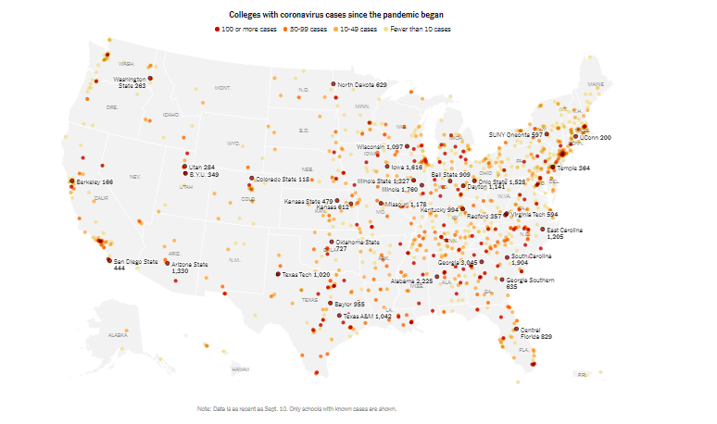
COVID-19 is on College Campuses
More than 88K cases have been linked to 1,190+ U.S. Colleges.
Illinois Urbana-Champaign: 1,760
Ohio State: 1,528
Wisconsin: 1,097
Iowa: 1,616
Source: The New York Times, as of Sept. 10.

Slide 30
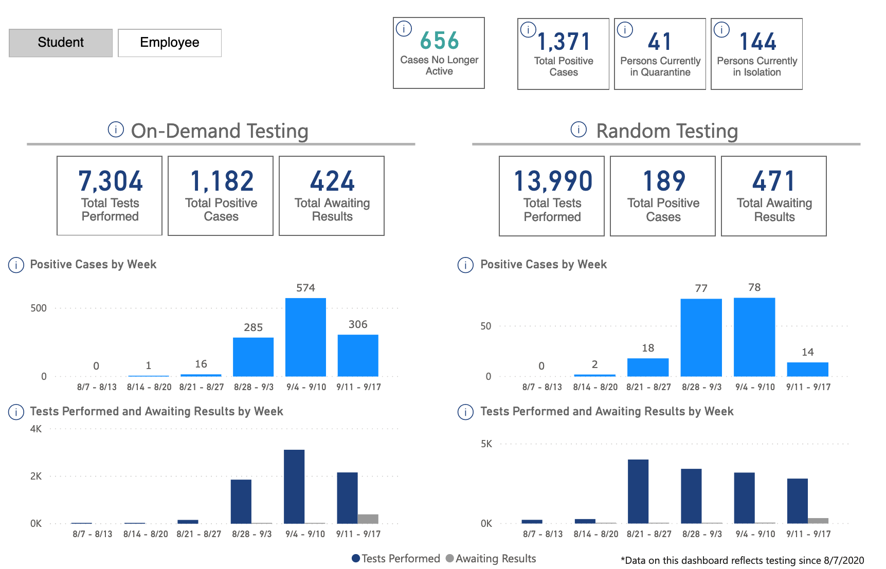
Penn State COVID-19 Dashboard – as of 9/17/20 (UP)
Total Student Tests: 21,294
Total Student Positives: 1,371 (since 8/7)
Faculty/Staff Cases: 1
Closed Cases: 656 (includes cases where individual is 10 days past quarantine or Isolation period)
During the past week (9/11-9/17):
Students (Asymptomatic):
2,822 tests performed
14 new confirmed cases
2,466 negative cases
342 awaiting results
Students (Symptomatic):
2,162 tests performed
306 new confirmed cases
1,461 negative cases
395 awaiting results

Slide 31
Guiding Principles for Off/On Ramps Planning
  Provide services in a manner that protects the health, safety, and well-being of staff while meeting the needs of the University.
  Department and/or unit plans will be flexible ensuring the ability to ramp up and down as circumstances dictate.
  Follow University and Commonwealth guidance for COVID-19.
  Maintain the department and/or unit in a state of readiness
  (i.e. staffing, equipment, and supplies to execute roles and responsibilities are available).

Slide 32
Off Ramp Factors
Case numbers are not the key
Quarantine and isolation capacity.
  Isolation capacity is 250 rooms; quarantine capacity is 150 rooms; and we have any additional 140 rooms available if needed.
  As of 9/17, at 58% capacity for isolation (144 people) and 27% for quarantine (41 people).
  As of 9/17, 656 closed cases – includes individuals who have moved out of isolation/quarantine space and cases where individual is 10 days past isolation or quarantine period.
Hospital Capacity
Community Spread

Slide 33
Examples of Possible Off Ramps
Reduce exposure by suspending use of specific buildings and spaces.
Quarantine a program or cohort.
Suspend or curtail some in-person programs.
Quarantine residents of a specific hall.
Pause in-person classes for a two-week period.
Pause programs at a specific campus
All programs and classes move online for an affected campus.

Slide 34
Summary
Favorable enrollment data, tuition payments and financial disbursements.
Research enterprise has topped $1.0 billion during one of the most challenging years in Penn State history.
Development had a record year in FY19-20 and has a strong start to FY20-21.
Comprehensive scenario planning is underway to quickly respond to potential changes in the COVID-19 off ramp factors.

